Slide 1
COMPUTER
PROGRAMMING

Slide 2
Computer programming
Computer Programming is defined as the process of creating computer software using a programming Language. Computer programs are written by Human individuals(Programmers)
A computer program is a step by step set of instructions that a computer has to work through in a logical sequence in order to carry out a particular task. The computer executes these instructions (obeys the instructions) when told to do so by the user.

Slide 3
Programming Languages
Programming languages are the vocabulary and set of grammatical rules for instructing a computer to perform specific tasks. There are many different types of programming languages each having a unique set of keywords (words that it
understands) and a special syntax (grammar)for organising program instructions.

Slide 4
Syntax
Syntax refers to the spelling and grammar of a programming language. Each program defines its own syntactical rules that control which words the computer understands, which combinations of words are meaningful, and what punctuation is necessary. Text-based programming languages are based on sequences of characters, while visual programming languages are based on the spatial layout and connections between symbols (which may be textual or graphical).

Slide 5
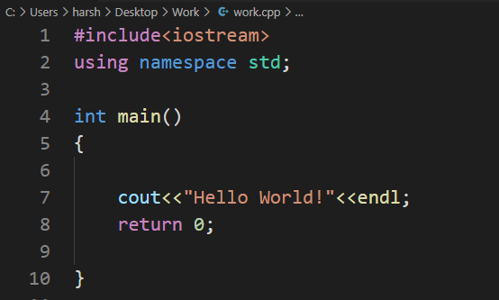
Example of Syntax

Slide 6
There are many computer programming languages and so the programmer will have to decide which one to use for solving a particular problem. These languages must be learnt just as English or French etc.

Slide 7
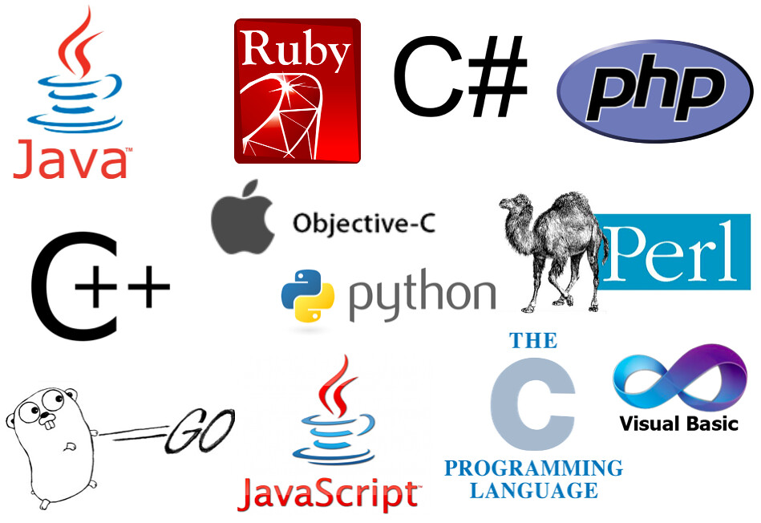
Examples of Programming languages

Slide 8
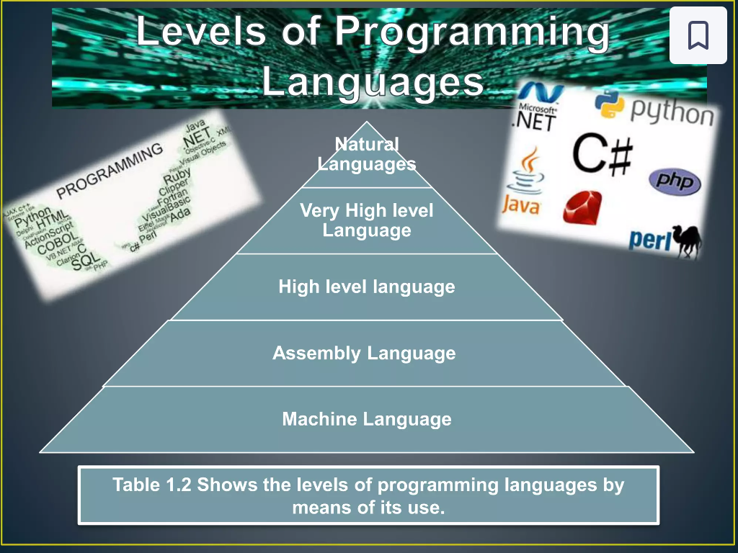
Levels of Programming Languages

